Slide 1
IS590PZ Project
Minimax AI on minichess(5*4)
Chunhao Shen

Slide 2
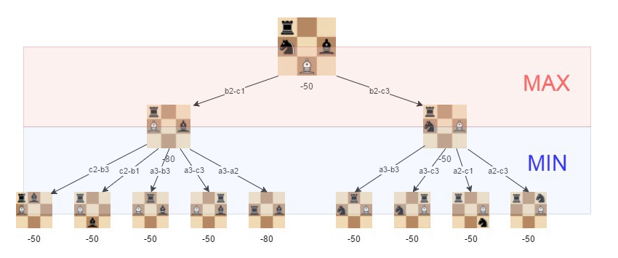
Minimax algorithm for AI

Slide 3
Evaluation for state
Pawn:1(-1)
Rock:5(-5)
Knight:3(-3)
Bishop:3(-3)
King:100(-100) useless
The end of game will return a large score so the king score is useless.

Slide 4
Code design
Class Board: contain a 5*4 vector<vector<Piece*>>
Many member function like move(), if_lose(), valid_move(), print() minimax()…
Class Piece: base class of derived class pawn, rock…
Contain a value, a color and a type.
Flexible design: By changing the #define HEIGHT AND WIDTH, and adding class Queen, it became a minimax AI engine for full-size chess. (Without castle and …)

Slide 5
Code design
How do we detect a end game like if_lose() or if_draw()?
My function if_lose() and if_draw() is based on another function if_check(). They all take in a current play’s color as input parameter.
By if_check(), we can simply test all possible move and see if in next stage the king still all got checked. If so then we conclude it loses.

Slide 6
Code design
Minimax() return the information contain the move index and the score, so last depth can do its work.

Slide 7
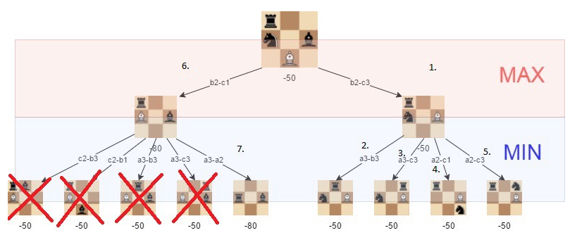
Possible Improvement
Alpha-beta pruning

Slide 8
Demo

Slide 9
Thanks!
Follow my github for more update. https://github.com/Pupilsch

